Slide 1
ASSC
Automatic Sleep Stage Classification
解正平 劉維凱 張景程

Slide 2
Outline
Introduction
Data acquisition
Preprocessing
Classification
XGboost
Deep neural network
XGB – Feature extraction
time analysis
frequency analysis
time frequency
Complexity measures
XGB – training
NN – Convolutional neural network
Architecture
Model description
NN – training
Classification Result
Application – alarm clock
Mindwave mobile
ThinkGear protocol
Package Decode
Android App
App inventor
App engine
Reference

Slide 3
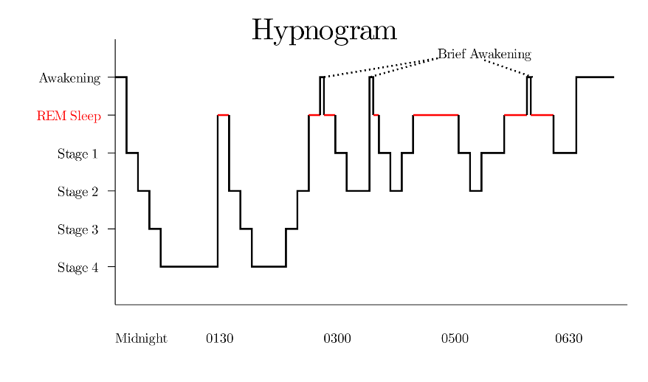
Introduction
Sleep stage Classification in machine learning
Non-linear model
Neural network
EEG feature analysis
Application for alarm clock

Slide 4
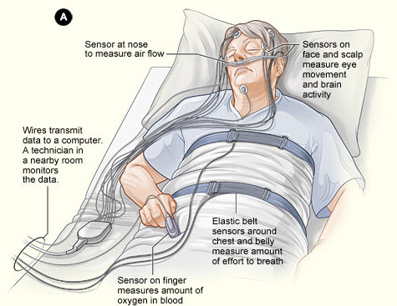
Data acquisition
EDF [expanded] database
SC file (20 subjects 40 files)
Record at home
2 nights = 40 hours
ST file (22 subjects 22 files)
Mild difficult falling asleep
Record at hospital
9 hours
EDF browser (.edf -> .csv)
hard to classify together

Slide 5
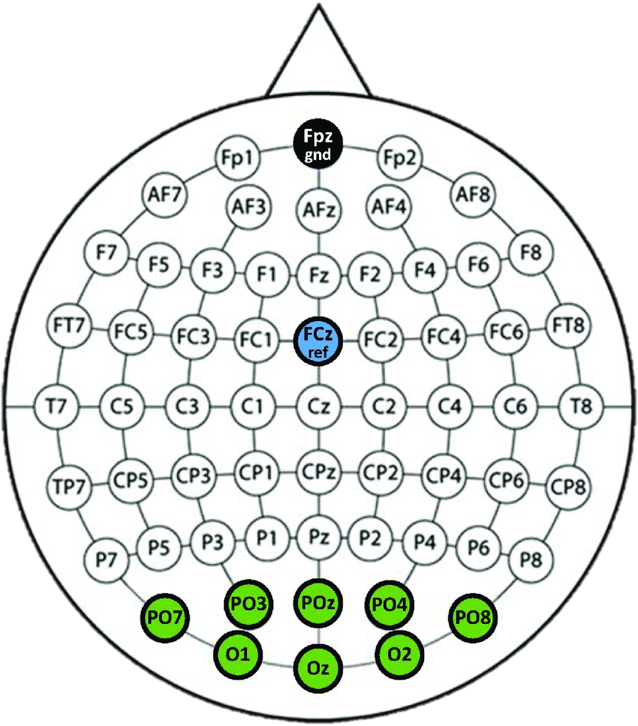
Preprocessing
1 epoch = 30s = 30*sampling rate(100Hz) = 3000 data
Remove forward and backward epochs while not sleeping
label in 6 stages [w, s1, s2, s3, s4, R]
label in 5 stages [w, s1, s2, s3, R]
Select [Fpz-Cz] single EEG signal

Slide 6
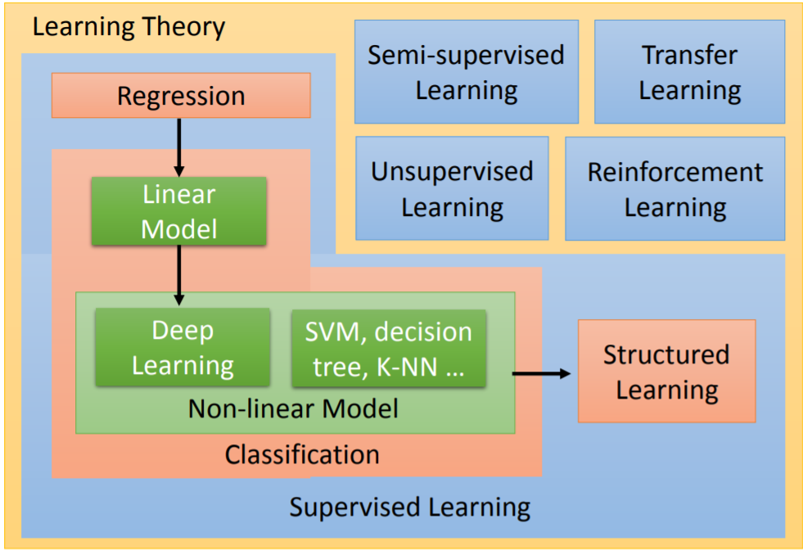
Classification
Xgboost
Feature extraction
Feature selection
Training
Neural Network
Build model
Training

Slide 7
XGboost

Slide 8
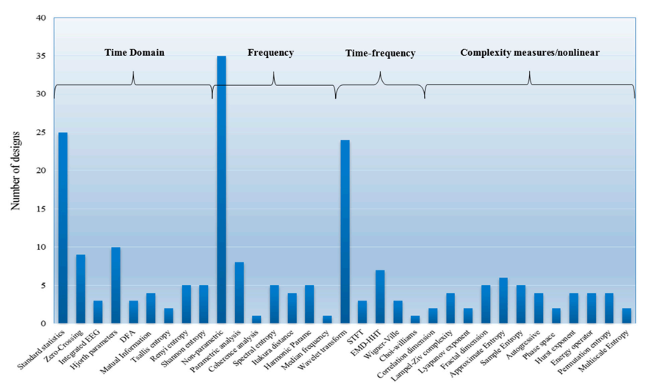
XGB – feature extraction
Time analysis
Standard statistics
Frequency analysis
Power ratio for delta, theta, low_alpha, high_alpha, beta
Time frequency
WT analysis
Complex measures
entropy
99 features 60 hours

Slide 9
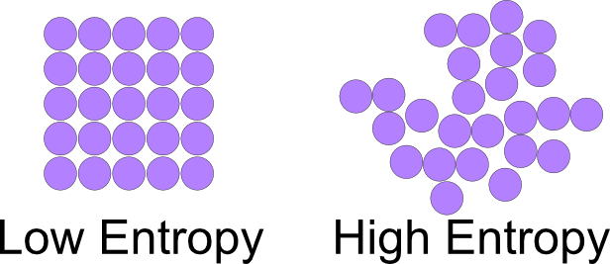
Complexity measures
Petrosian Fractal Dimension
Detrended Fluctuation Analysis
Hurst exponent
Shannon entropy
Spectral entropy
Approximate entropy
Maximum-minimum distance
Energysis

Slide 10

XGB - training
Regression tree
6 fold validation, early_stop = 10
Feature selection
Set threshold to retrain

Slide 11
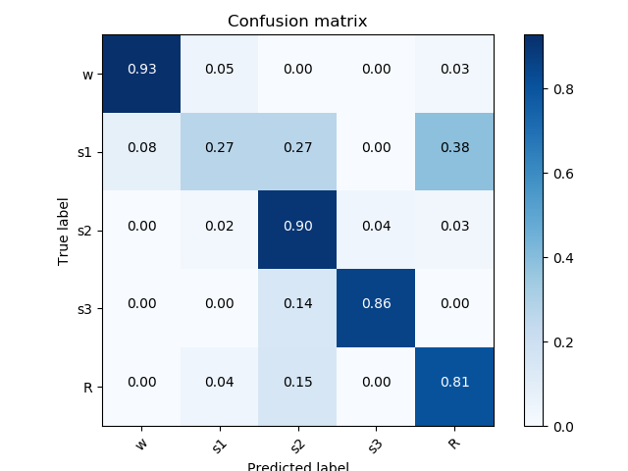
XGB - accuracy
Validation accuracy = 0.824
Testing accuracy = 0.834
F1 score = 0.760
Sensitivity = 0.834
[w, s1, s2, s3, R]
= [151, 78, 452, 148, 171]

Slide 12
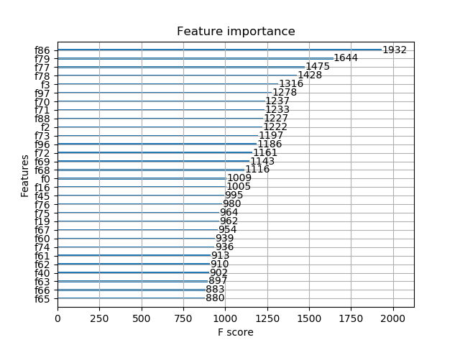
XGB – plot importance
PFD (86) | Esisen high alpha (97)
DWT mean cA6/cD5 (79) | DWT std cA6 (70)
DWT mean cD4/cD3 (77) | DWT avgPower cA6 (71)
Dwt mean cD5/cD4 (78) | Hurst exponent(88)
Kurt (3) | Skew (2)

Slide 13
XGB – feature select
Feature size | Train acc | Train f1 score | Test acc | Test f1 score | sensitivity
18 | 0.9089 | 0.8842 | 0.8384 | 0.7665 | 0.7602
99 | 0.9545 | 0.9411 | 0.8286 | 0.7721 | 0.7659

Slide 14
Deep Neural Network

Slide 15
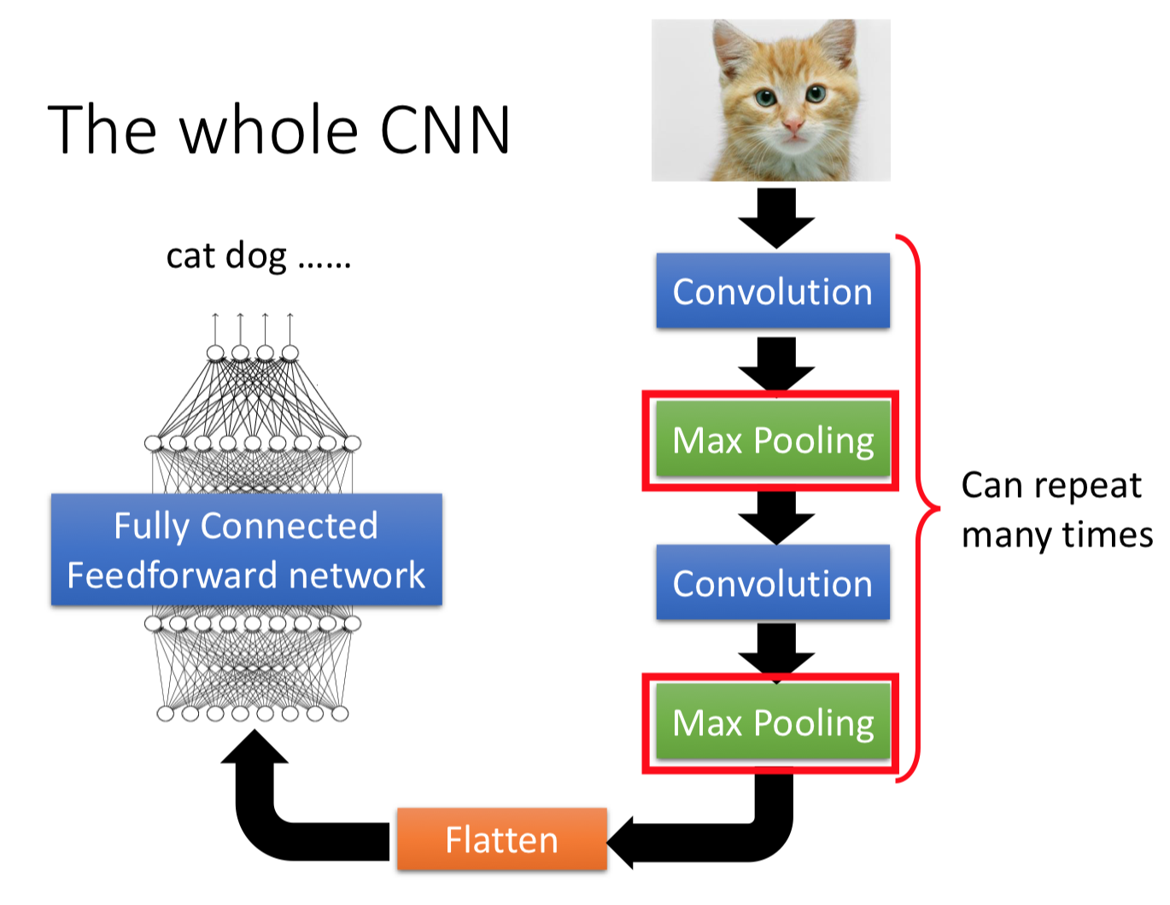
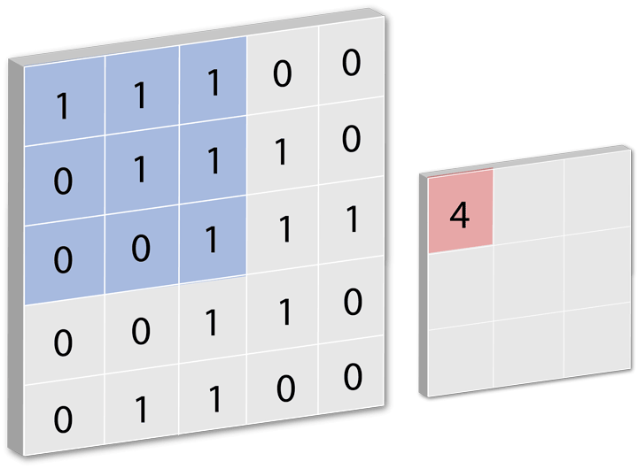
Convolutional Neural Network
How it works…

Slide 16
CNN - model architecture
64 Conv , 50
MaxPool, 8
128 Conv , 8
128 Conv , 8
128 Conv , 8
MaxPool, 4
Fully Connected, 1024
FC , 5
30S EEG signal
out
64 Conv , 400
MaxPool, 4
128 Conv , 6
128 Conv , 6
128 Conv , 6
MaxPool, 2

Slide 17
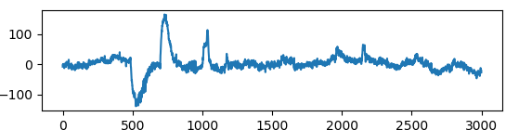
CNN – input raw data

Slide 18
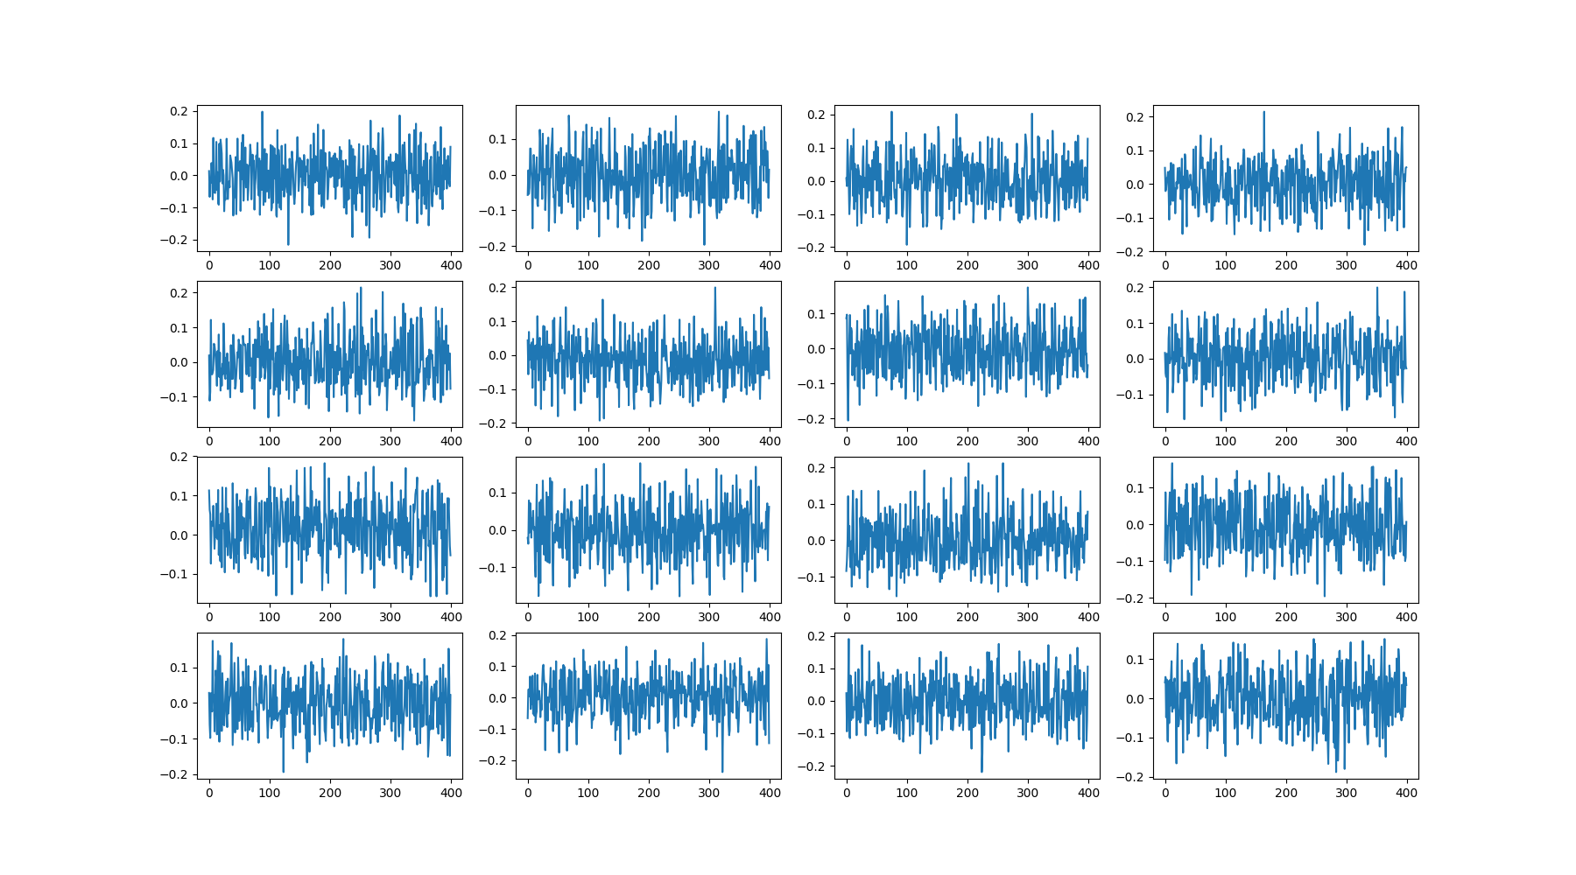
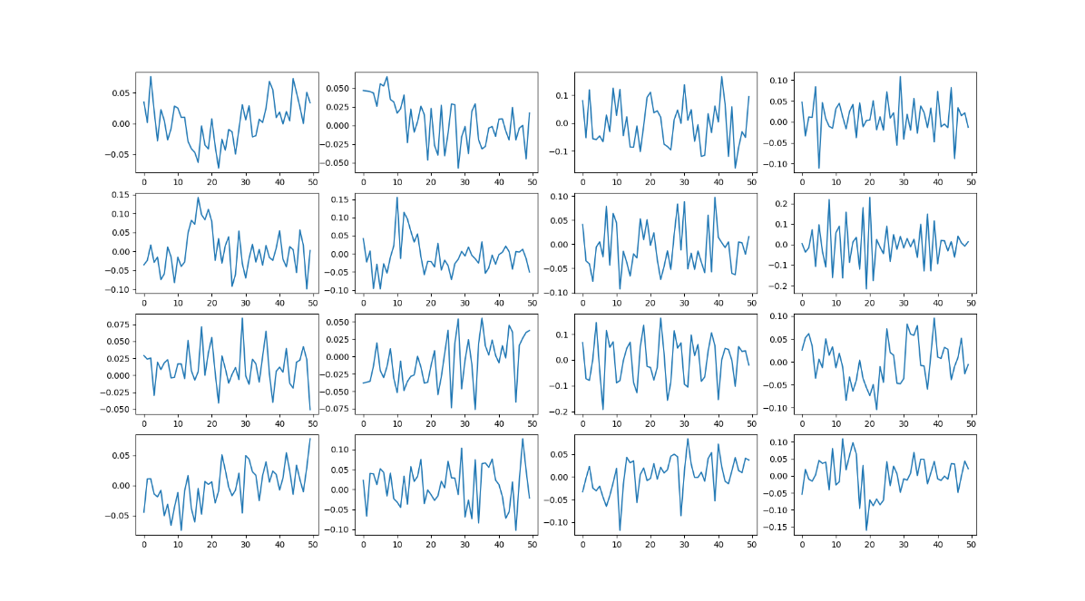
CNN – model description
Utilizes two CNNs with different filter sizes at the first layers.
- Extract features from raw single-channel EEG.
Small filter : capture temporal information (certain EEG pattern)
Large filter : capture frequency information

Slide 19
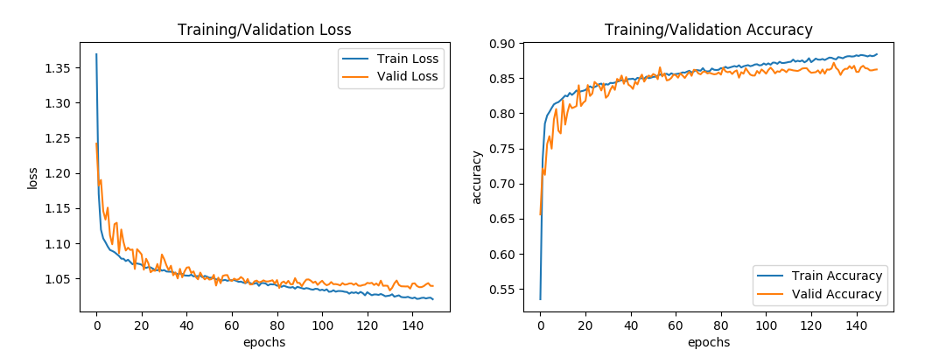
Learning Curve
Testing accuracy : 0.86 (1720/2000)

Slide 20
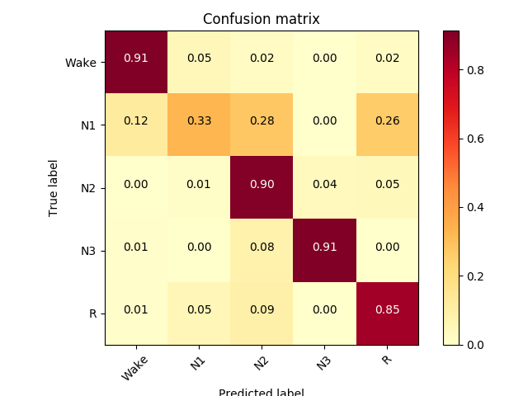
CNN – confusion matrix

Slide 21
Application

Slide 22
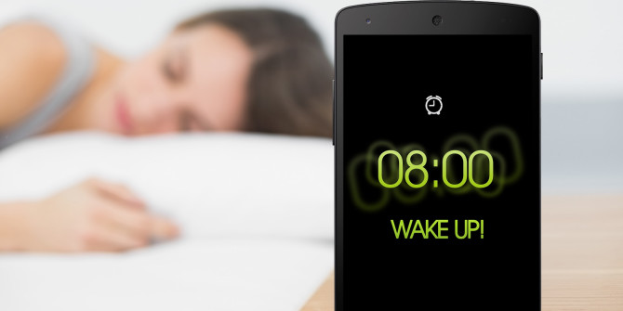
Application – alarm clock
Wake up in a comfortable mood
Moitor sleep quality
App connect to Internet

Slide 23
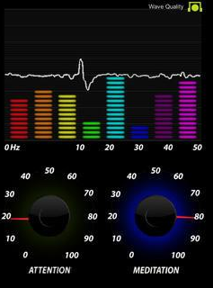
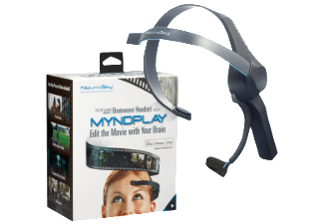
Mindwave mobile
Get EEG raw data
AAA battery
Bluetooth

Slide 24
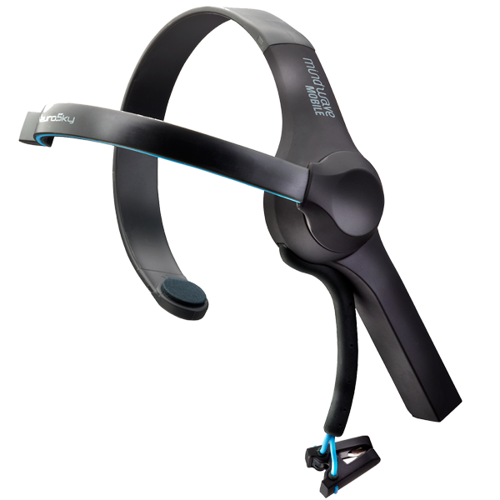


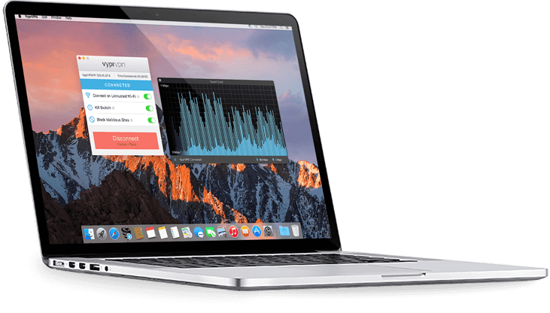
Mindwave – ThinkGear protocol
Value introduction
Package structure
Command bytes

Slide 25
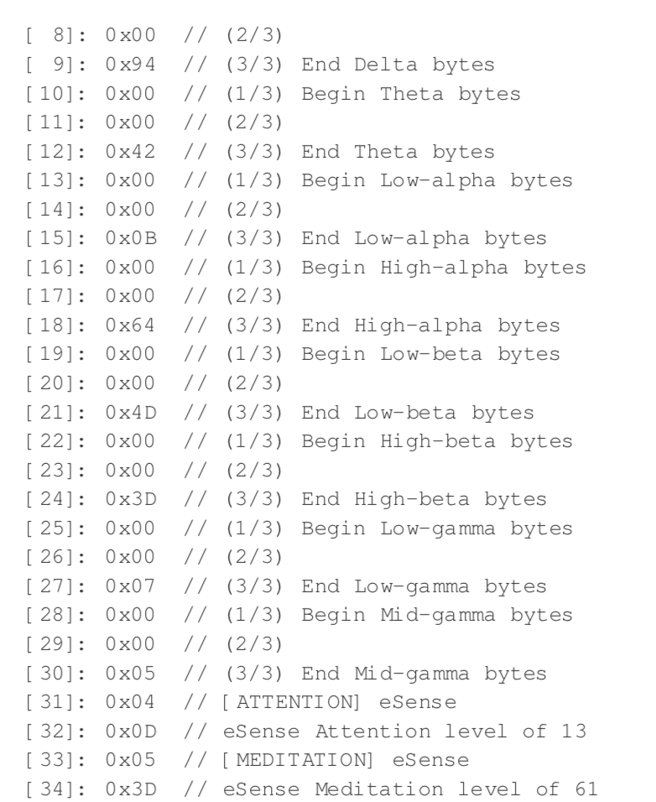
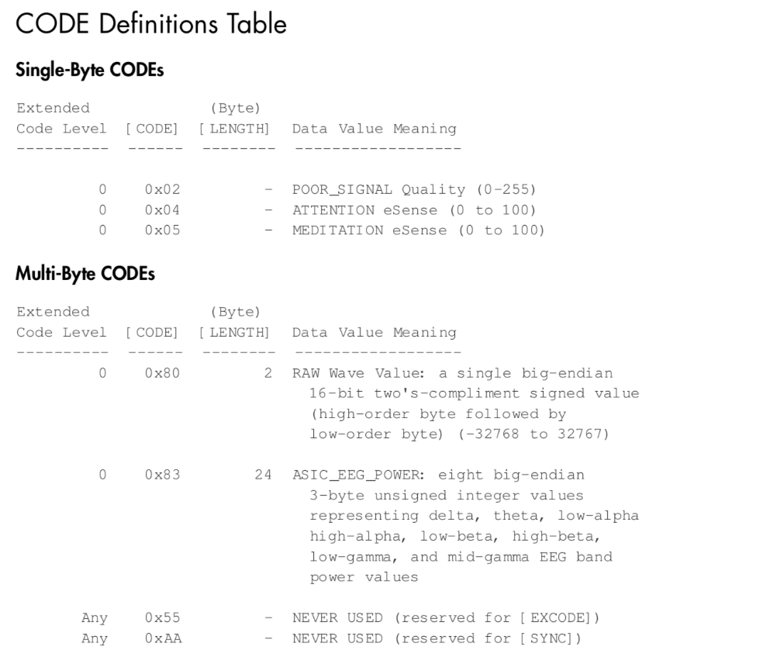
Mindwave – package decode
header and payload

Slide 26
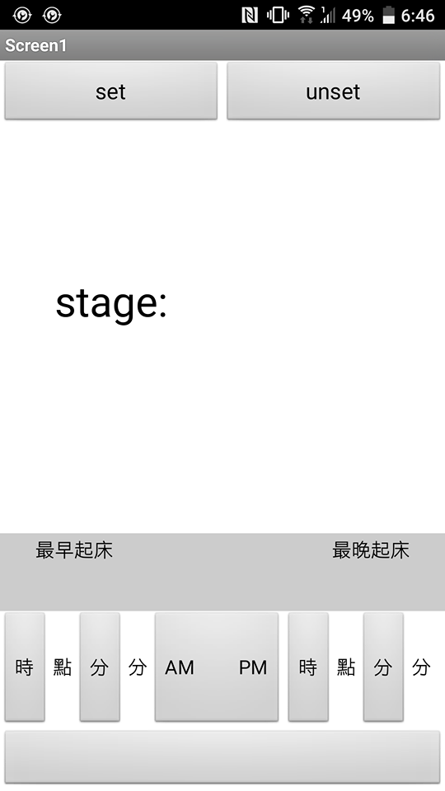
Android App
Alarm at a specified time
Alarm in a specified time interval
Get value from cloud drive

Slide 27
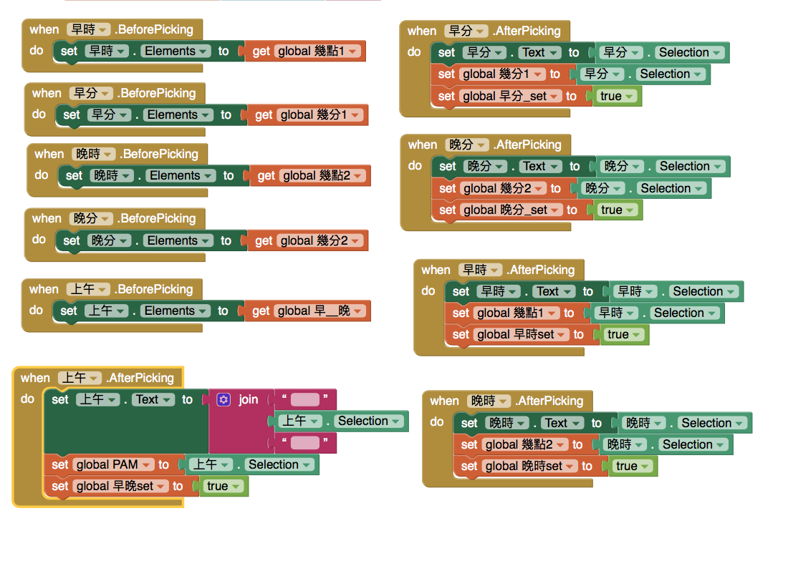
App – App inventor
Sexagesimal
am. and pm.

Slide 28
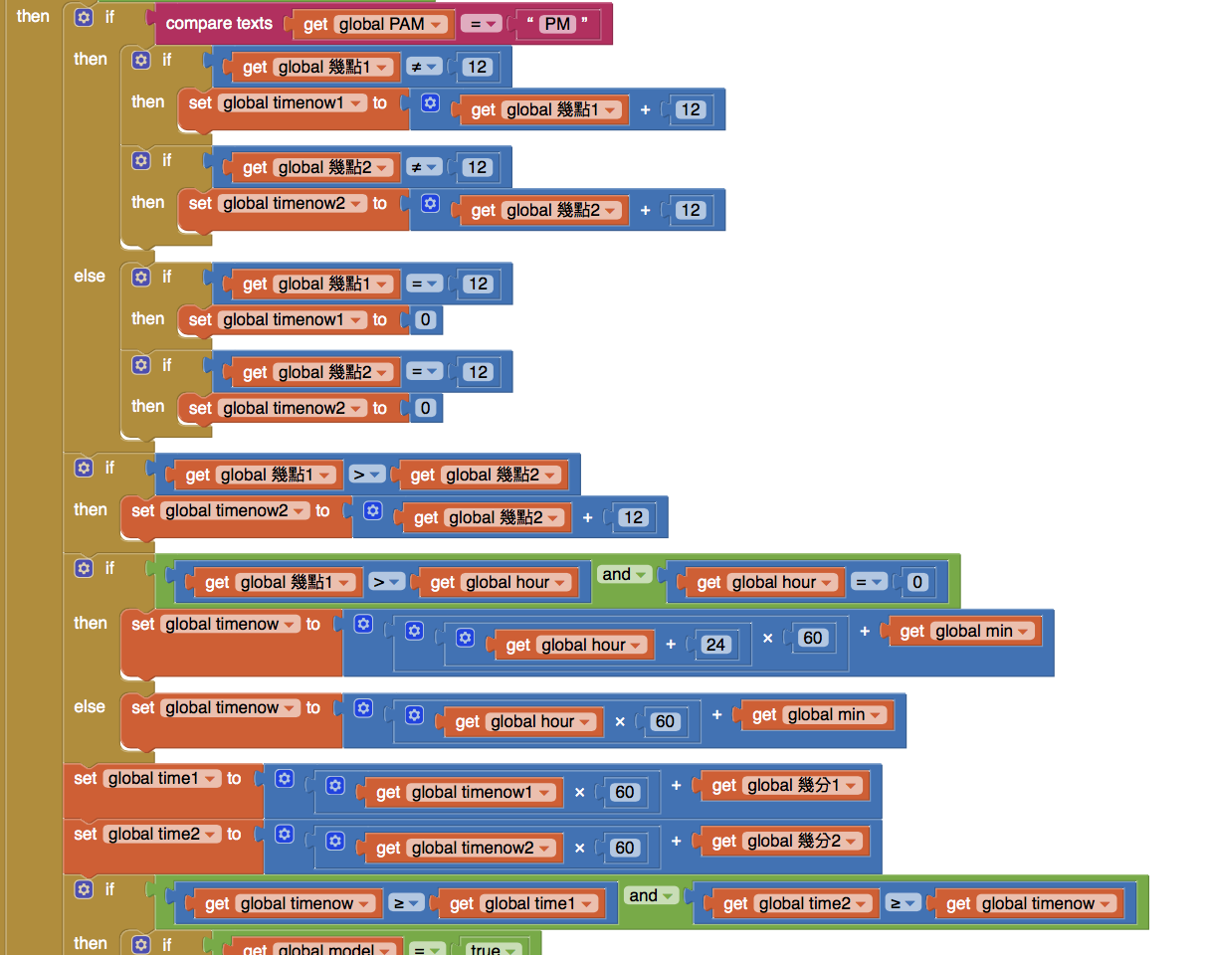
App – App inventor
Special treatment at 11 pm. to 01 am.

Slide 29
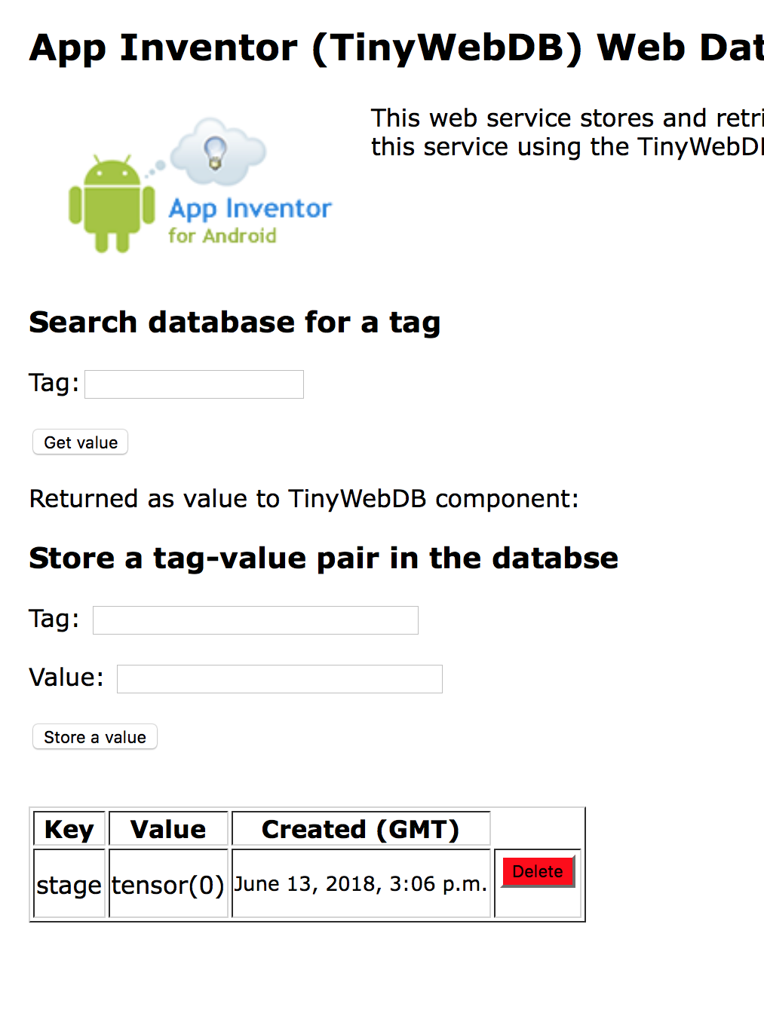
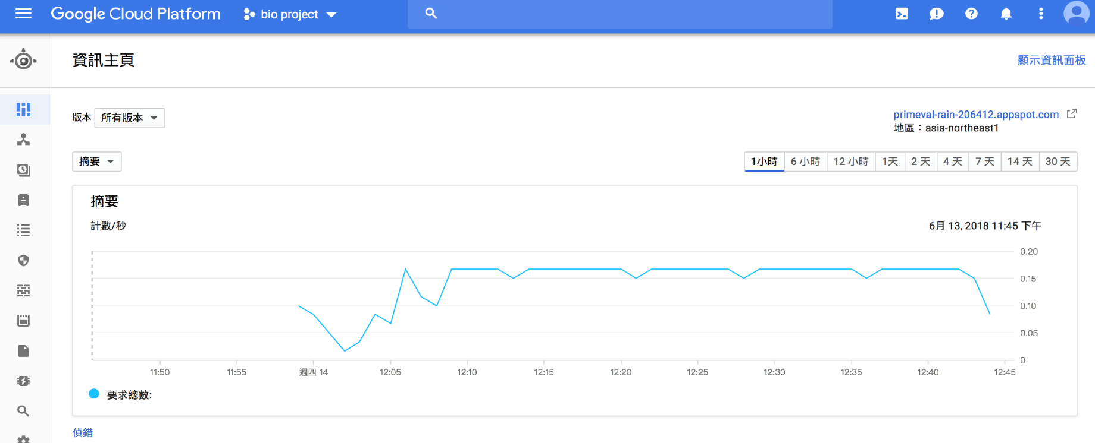
App – App engine
Google app engine
A Server to enable inventor access

Slide 30
Reference
[1] Alickovic, Emina, and Abdulhamit Subasi. "Ensemble SVM method for automatic sleep stage classification." IEEE Trans. on Instrumentation and Measurement (2018).
[2] Nakamura, Takashi, et al. "Complexity science for sleep stage classification from EEG." Neural Networks (IJCNN), 2017 International Joint Conference on. IEEE, 2017.
[3] Ebrahimi, Farideh, et al. "Automatic sleep stage classification based on EEG signals by using neural networks and wavelet packet coefficients." Engineering in Medicine and Biology Society, 2008. EMBS 2008. 30th Annual International Conference of the IEEE. IEEE, 2008.
[4] Aboalayon, Khald Ali I., et al. "Sleep stage classification using EEG signal analysis: a comprehensive survey and new investigation." Entropy 18.9 (2016): 272.
[5] Yulita, Intan Nurma, Mohamad Ivan Fanany, and Aniati Murni Arymurthy. "Combining Deep Belief Networks and Bidirectional Long Short-Term Memory." Proceeding of the Electrical Engineering Computer Science and Informatics 4 (2017): 88-93.
[6] Chambon, Stanislas, et al. "A deep learning architecture for temporal sleep stage classification using multivariate and multimodal time series." arXiv preprint arXiv:1707.03321 (2017).
[7] Zhang, Junming, and Yan Wu. "A New Method for Automatic Sleep Stage Classification." IEEE transactions on biomedical circuits and systems 11.5 (2017): 1097-1110.

